Slide 1
Course Introduction
Welcome to CSE 390B!
Introduction to CSE 390B, Course Logistics, Project Overview

Slide 2
Lecture Outline
What is CSE 390B About?
  Overview of CSE 390B
  Why the Course Matters
Course Logistics
  Lectures and Assignments
  Course Policies and Resources
Programming Project Series
  Nand2tetris Overview
  Tools demonstration

Slide 3
What is CSE 390B?
The UW Student Experience
Math
Metacognitive
Skills
CSE
History
Nand2Tetris
Projects
Sociology
CSE 390B

Slide 4
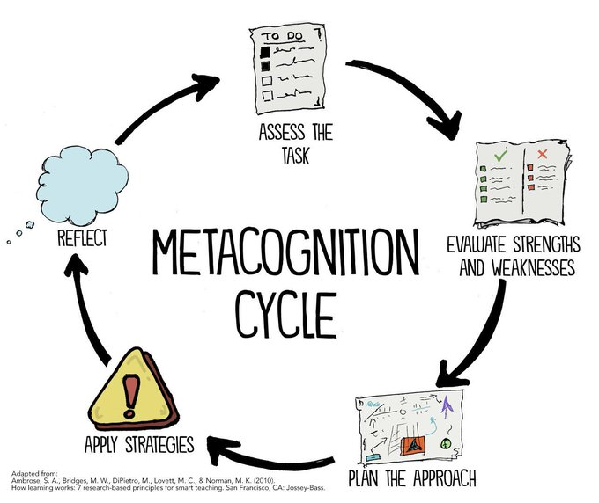
Metacognitive Skills
What does metacognition mean?
  Awareness of your thought process
Metacognitive skills we will cover:
  Time Management
  Annotation Strategies
  Exam Preparation
  Test-Taking
  Note-Taking
  Written & Oral Communication
  Testing & Debugging
  Design Decisions

Slide 5
The Connection
How do the different elements of practicing metacognitive skills and working on technical projects connect?
DEFINE & PREPARE
Introduce technical content and a new metacognitive skill
REFLECT
PRACTICE!
What was challenging? What worked well?
Applying knowledge through weekly projects

Slide 6
Sneak Peek of CSE 390B
Fascinating question:
  What happens under the hood when code runs?
Fascinating answer:
  Many layers of abstraction, each with its own answer
Nand2tetris: Project for exploring bottom-up layers
  Can do everything with NAND gates and input / output
An empowering, coordinated, broad look at “how computers really work”
  Closest to the Hardware / Software Interface CSE 351 but lower level, with elements from Digital Design (CSE 369), Operating Systems (CSE 451), and Compilers (CSE 401)

Slide 7
Why Does CSE 390B Matter?
Technology is based on bottom-up computing
  Learning how computers work is foundational to computer science
  You’ll see the birds-eye view of computer science and understand how your courses fit into the big picture
This course equips you with a toolbox
  A CSE degree isn’t just about learning technical concepts
  A college education is also about preparation for a career and your future (collaboration, organization, etc.)
This course empowers you to explore
  You will become independent learners and be autonomous in your learning for future UW courses and beyond

Slide 8
Lecture Outline
What is CSE 390B About?
  Overview of CSE 390B
  Why the Course Matters
Course Logistics
  Lectures and Assignments
  Course Policies and Resources
Programming Project Series
  Nand2tetris Overview
  Tools demonstration

Slide 9
Succeeding in CSE 390B
This course will have frequent assignments and move through many topics
  Stay organized, falling behind makes it difficult to catch up
  You will not be successful in this course if you wait until the day before to do your assignments
This course rewards participation
  Lecture participation is expected
  In-class activities are meant to help you with your weekly projects
Like other college courses, earning a good grade requires that you put in the effort
  What you get out of the course is what you put in
  We expect students to work hard and give their best effort

Slide 10
Course Staff Roles
Eric
Teaching the technical (bottom-up computing) and metacognitive (academic skill building)
Ghislaine and Preston
Weekly TA meetings as a touch point in practicing the application on course concepts and study skills
The UW Student Experience
CSE
Metacognitive
Skills
Math
Eric
Nand2Tetris
Projects
English
Ghislaine & Preston
Sociology
CSE 390B

Slide 11
Grading Breakdown
40%: A sequence of eight projects
  Each will have a metacognitive and technical, programming component
  Projects will be assigned on Thursdays and generally due the following Thursday
20%: Midterm Exam
20%: Final E-Portfolio Project & Presentation
20%: Participation
  10%: Lecture attendance and Poll Everywhere questions
  10%: Student-TA meeting attendance and engagement

Slide 12
Academic Integrity
Work to be completed and submitted individually
  Do not share your solutions with others
Collaboration allowed and encouraged, but discussions must be at a high-level
  You may share implementation strategies and debugging tricks, but NOT lines of code or your entire solution
Do not seek answers or solutions from those not in the class or from the website
If you have any questions about what is considered academic integrity or not, please ask the course staff

Slide 13
Student-TA Meetings
Weekly 1:1 Student-TA Meetings
  A required element of the course (factored into participation grade)
  45 minutes each week (the first meeting will be one hour)
  1:1 Student-TA meetings will begin Week 2 based on the availability of you and the TA
Student Expectations
  Come prepared, on time, and ready to discuss with your TA
  Tardiness, absences, or frequent rescheduling will negatively impact your participation grade

Slide 14
Lecture Polling
A way for you to instantly practice and solidify the concepts covered in lecture
  Research shows the act of thinking about an application question is a highly effective way to learn
Factored into participation grade (completion only)
We will be using Poll Everywhere
  Sign up now for an account at https://pollev.com/
  Requires SSO log-on

Slide 15
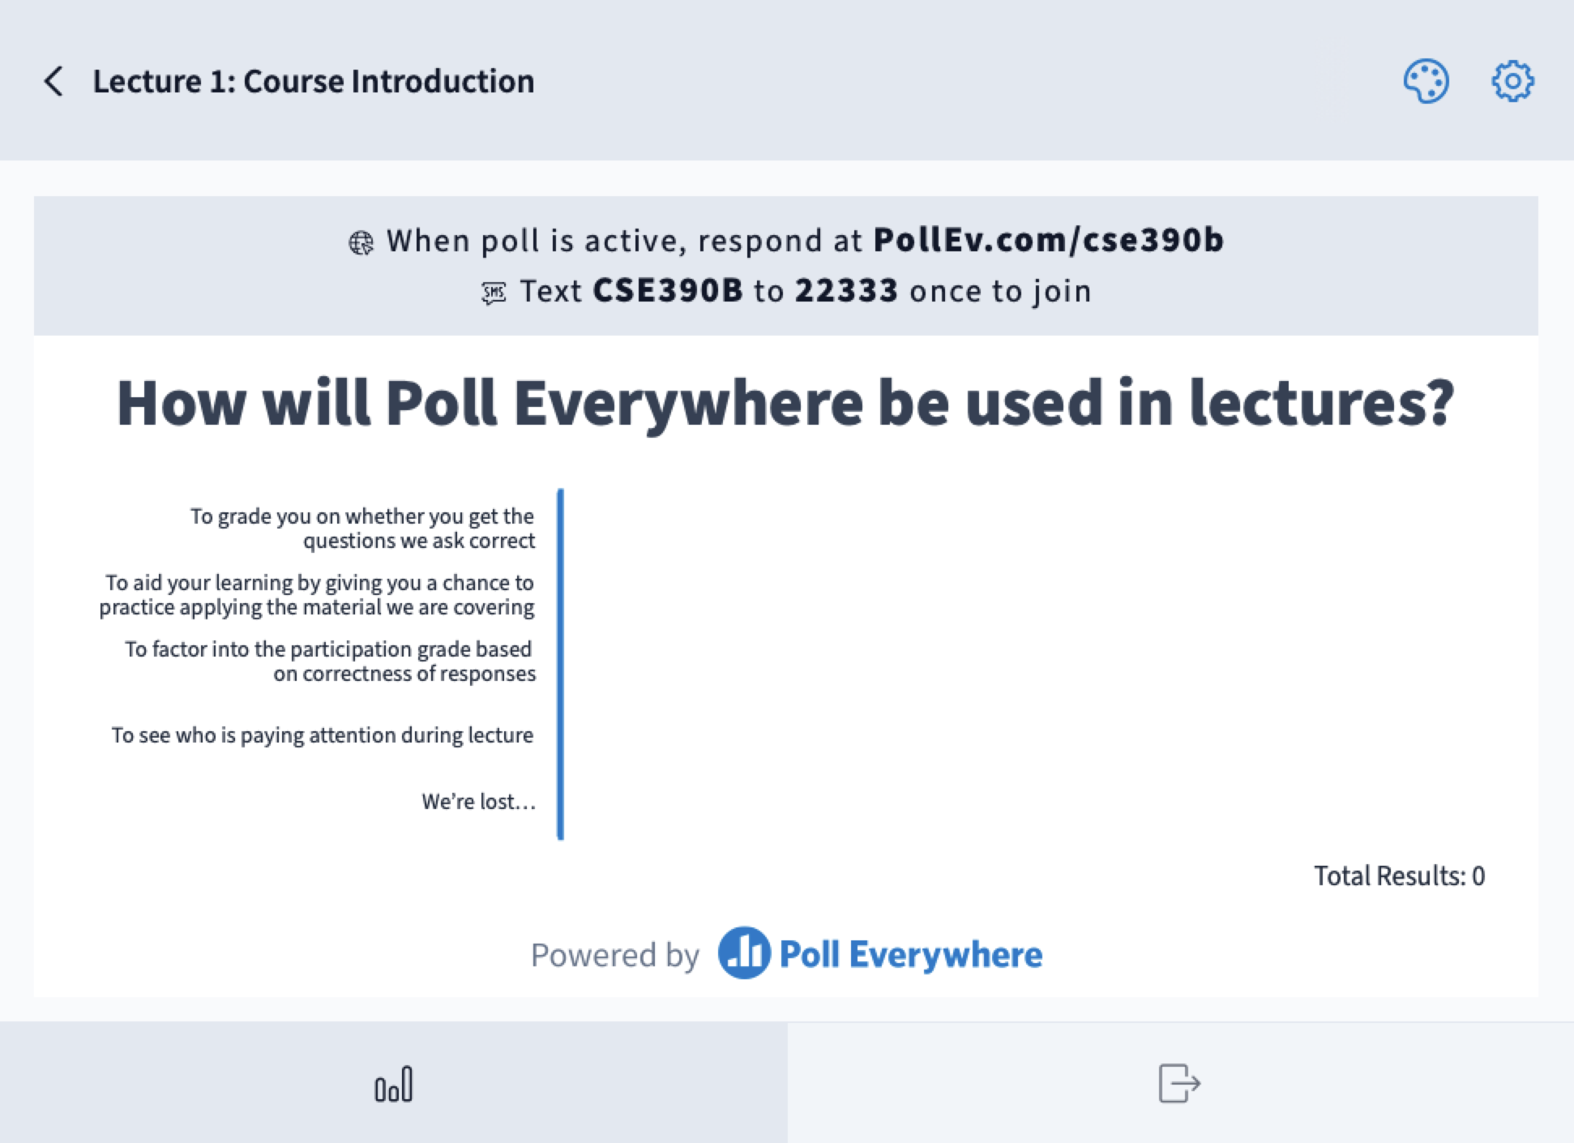

Slide 16
Late Policy
Five late days for the quarter
  Do not need to tell the course staff ahead of time
  Maximum of two late days can be used per project
Guaranteed to pass if you earn a raw score of at least 50% on each project, all submitted by the end of the quarter
  Importance of staying persistent and resilient
In extenuating circumstances, you may ask for an extension
  Only considered if the request is made before the project deadline
  See syllabus for extension request instructions
10% deduction per additional late day

Slide 17



Course Resources
Course Webpage
  Main source for everything related to CSE 390B
  Includes syllabus, course calendar, project specifications, and all the relevant resources for the course
Canvas
  Access to lecture recordings via Panopto
  Check remaining late days (updated after every project)
  Accessing necessary resources for projects
Gradescope
  Where you will submit the metacognitive parts of the projects
  You will receive your project grades and feedback here

Slide 18



Course Resources
GitLab
  Project distribution and submission of technical, programming parts of the projects
Ed Discussion Board
  The place to ask and answer questions related to the class (logistics, projects, general questions, etc.)
  Course staff will post announcements here
Email the course staff: cse390b-staff@cs.washington.edu
  You may also reach the course staff over email if you’d like
  Usually a faster response over email

Slide 19
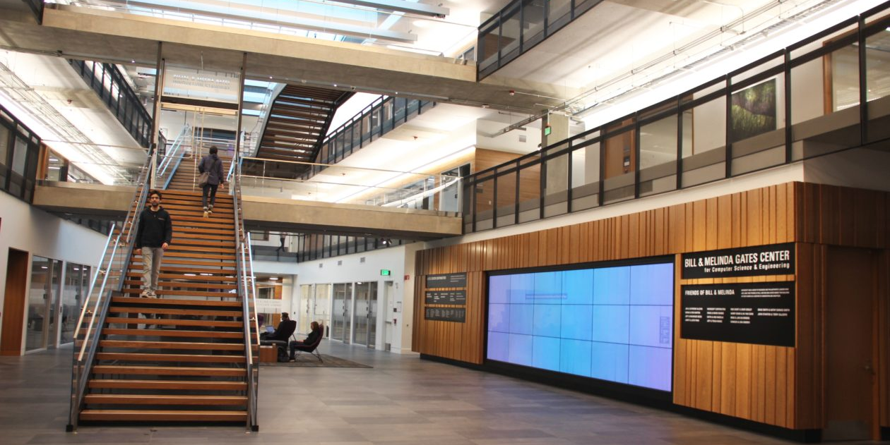
Course Resources
Located in one of the TA offices
A space for you to ask questions and receive help on technical projects and metacognitive concepts
Feel free to also stop by to just work on projects or say hello!
Office hours times and location posted on the course calendar (still TBD)

Slide 20
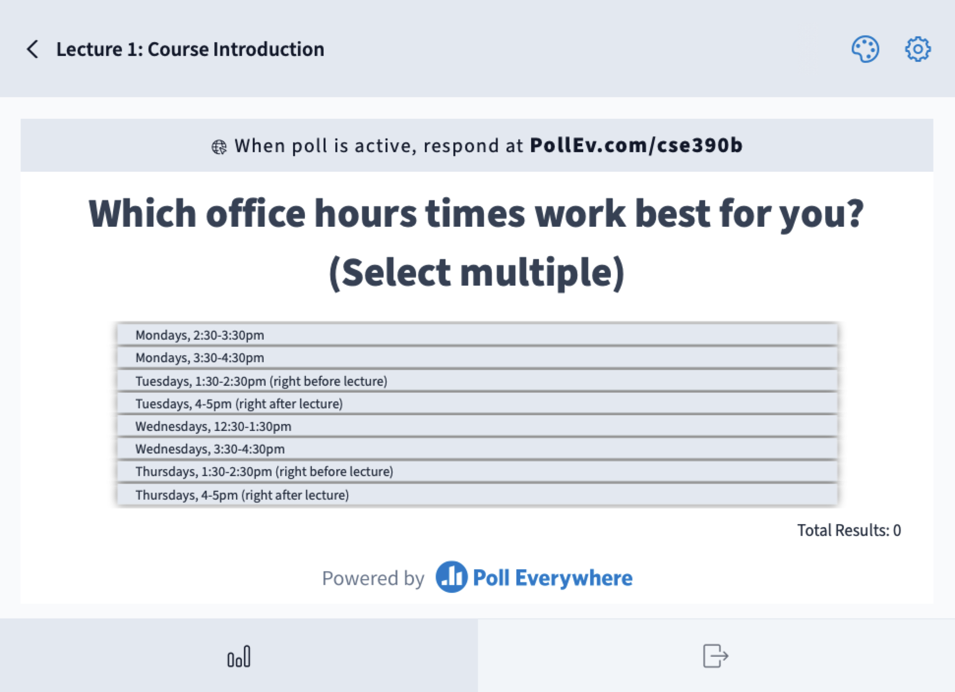

Slide 21
Lecture Outline
What is CSE 390B About?
  Overview of CSE 390B
  Why the Course Matters
Course Logistics
  Lectures and Assignments
  Course Policies and Resources
Programming Project Series
  Nand2tetris Overview
  Tools demonstration

Slide 22
Programming Project Series
nand2tetris
  You will build an entire (simulated) computer
  Source: Single hardware logic gate
  Destination: A computer program that runs a game of Tetris
  Topics: Hardware concepts (Boolean logic, sequential logic, computer chips, etc.), low-level software, fundamentals of operating systems, virtual machines, compilers
Acknowledgements
  Projects adapted from the open-source nand2tetris curriculum
  Everything you need will be distributed by the course staff

Slide 23
Programming Project Series
Getting your assignments: you will have your own GitLab repository for the quarter
  For distributing starter code
  Used for organizing and submitting your projects
Specifications, textbook chapters, and references will be on the course website
  We’ll provide the instructions you need for using Git
We will generally grade a project by the date the next project is due (approximately one week after the deadline)

Slide 24
Programming Project Series
Roadmap for completing the programming projects:
In lecture:
Read spec & textbook chapter about specific application
Technical concepts
Try writing code in your preferred text editor
Metacognitive skills
Test & debug using provided simulator tools
Complete reflection on the process

Slide 25
Project 1 Overview
Programming Component: GitLab Setup
  Will help prepare you for future CSE 390B projects
Metacognitive Component: Course Resources Worksheet and Project 1 Reflection
  Organize your resources for this autumn quarter
  Identify key learning resources that you will be accessing throughout the quarter
Estimated time to complete: 1-2 hours
Project 1 due this Thursday (1/5) at 11:59pm

Slide 26



Project 1 Demo
Understanding and using Git
Find your CSE 390B GitLab Repository
Add your SSH Key
Explore the starter code using your favorite editor
Make a commit
Steps outlined in detail in Project 1 webpage

Slide 27
Post-Lecture 1 Reminders
Project 1 due this Thursday, 1/5 at 11:59pm
Please post on the Ed discussion board any questions you have from Project 1
See you all this Tuesday! 👋

